Slide 1
minimum wage, preemption, and health/educational outcomes
Carrie Aponte
CIS 598
Advisors: Lior Shamir, Safia Malallah
5/6/24

Slide 2
introduction
Data Science research project
Concurrent work with Data Science in Practice class
For capstone: Adding additional data, developing dashboard and publication material
Project is part of KDSC (Kansas Data Science Consortium) and ARISE (Adaptive and Resilient Infrastructure driven by Social Equity)
Project is serving a community partner – Wyandotte County
Notes:
This project is done concurrently with another class, adding requirements and features for capstone, working with research mentors.
**who is the audience, where is the data from, what are we trying to find
Project is a part of the **spell out arise acronym**(ARISE) and KDSC
**information about project serving a community partner – the Wyandotte county people ☺
Investigating effects of minimum wage and minimum wage preemption on negative health effects and educational outcomes
Original project goals:
Investigating effects of minimum wage preemption on health outcomes
Additional project goals:
Investigating effects of minimum wage and minimum wage preemption on health and educational outcomes

Slide 3
Data Science life cycle
Domain Knowledge and Research Design
Data Planning and Data Collection
Data Cleaning - Data wrangling
Data Exploration - Feature Engineering
Data Exploration - Feature Selection
Model - Model Design
Model - Model Evaluation
Communication and Propose Action

Slide 4
project Background
Does minimum wage preemption have a relationship with various poor health outcomes?
Importance: The Federal Minimum Wage has not increased since 2009, though cost of living has continually increased. Minimum wage preemption restricts local authorities from increasing minimum wage
Studies have shown link between wages and preemption on health outcomes
Do minimum wage/preemption and health outcomes have a relationship with higher education outcomes?
Higher education is expensive and time consuming (requires privileges)

Slide 5
related work
State preemption of minimum wage and sick leave contributed to working-age mortality from external causes (suicide, homicide, drugs)
Wolf, D., Karas Montez, J., Monnatt, S. (2022). U.S. state preemption laws and working-age mortality. American Journal of Preventive Medicine.
10% minimum wage increase improves women’s general health
Sigaud, L., Daley, A., Rubin, J., Noblet, C. (2022). The effects of recent minimum wage increases on self-reported health in the United States. Social Science & Medicine.
Doubling wages associated with decreased risk of hypertension diagnoses
Brown-Podgorski, B. L., Doran-Brubaker, S., & Vohra-Gupta, S. (2023). State minimum wage increases as a potential policy lever to reduce black-white disparities in hypertension.
At least 605 infant deaths have resulted from minimum wage preemption laws
Wolf, D. A., Montez, J. K., & Monnat, S. M. (2022). U.S. state preemption laws and working-age mortality. American Journal of Preventive Medicine, 63(5), P681-688.

Slide 6
related work cont.
College tuition increases around 8% per year, and the cost of public universities in the U.S. has nearly tripled since 1980.
Rivera, H. (2023, July 26). College Tuition Inflation. Bankrate.
Physical health increases academic success
Flaherty, C. (2023, May 31). Physical Health and Wellness Linked to Student Success. Inside Higher Ed.
Higher minimum wages correspond to lower levels of community college enrollment
Lee, Chang Hyung. “Minimum Wage Policy And Community College Enrollment Patterns.” Ilr Review, vol. 73, no. 1, 2020, pp. 178–210. JSTOR.
Women/mothers ability to pursue post-secondary education is affected by low income
Polakow, V., Butler, S., Deprez, L., & Kahn, P. (2004). Shut Out, Low Income Mothers and Higher Education in Post-Welfare America.

Slide 7
hypothesis/methodology
Investigating the relationships between the variables
No stated hypothesis – goal is to discover insights from the data
Null hypothesis: There is no relationship between the minimum wage and health/educational data

Slide 8
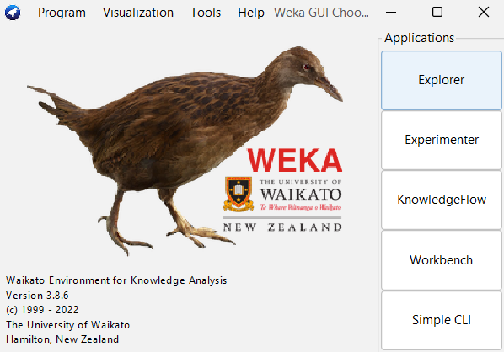
tools used
Excel
Weka
Scikit Learn
Python
Power BI for Dashboard/Visualization

Slide 9
Data Science life cycle
Domain Knowledge and Research Design
Data Planning and Data Collection
Data Cleaning - Data wrangling
Data Exploration - Feature Engineering
Data Exploration - Feature Selection
Model - Model Design
Model - Model Evaluation
Communication and Propose Action

Slide 10


data collection
health/wage DATAset
Signed agreement with ARISE for initial data
Provided by community partner (Wyandotte County)
Ordered by state
Minimum wage, preemption status, various health statistics
Data Format:
50 rows
Each State
22 columns
Health and Wage Information

Slide 11

data collection
CDS DATAset
R1 Public Universities in United States
2022-2023 CDS selected
108 Universities (44/50 states)
99 Sampled (42/50 states)
Accessible in PDF, CSV, Web Format
Created Python scripts for data scraping – too many CDS formats for efficiency
Manually collected data from CDS
80 Original Data Points,120 Ending Data Points
Calculated percentages for various parameters (e.g., percent undergraduate women, percent Hispanic undergraduates, percent received Pell Grants)

Slide 12
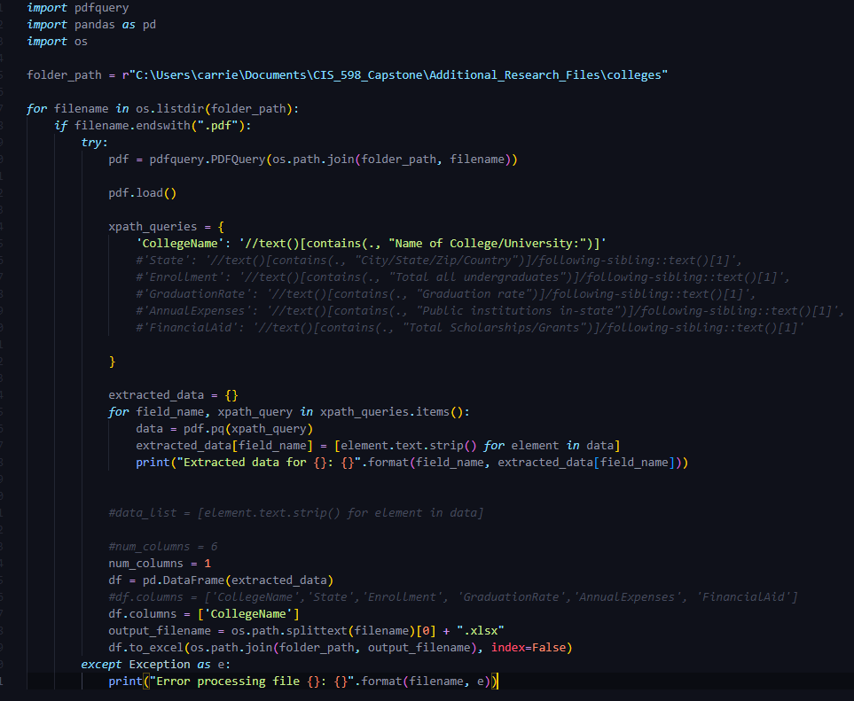
data scraping from pdf

Slide 13
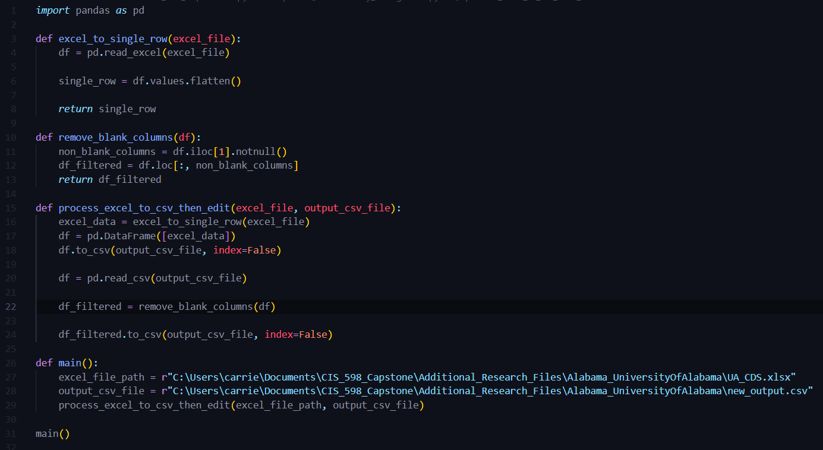
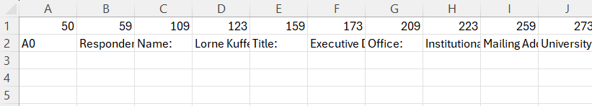
data scraping from excel file

Slide 14
Data Science life cycle
Domain Knowledge and Research Design
Data Planning and Data Collection
Data Cleaning - Data wrangling
Data Exploration - Feature Engineering
Data Exploration - Feature Selection
Model - Model Design
Model - Model Evaluation
Communication and Propose Action

Slide 15
Data wrangling
health/wage DATAset
Data Formatting
Missing Values: Imputations applied by gathering average of column totals
Converted xlsx file to csv, manually removed erroneous symbols such as “” and ,
Data Exploration:
Described and understood variables
Using Weka, determined max/min/mean of variables and their distribution

Slide 16
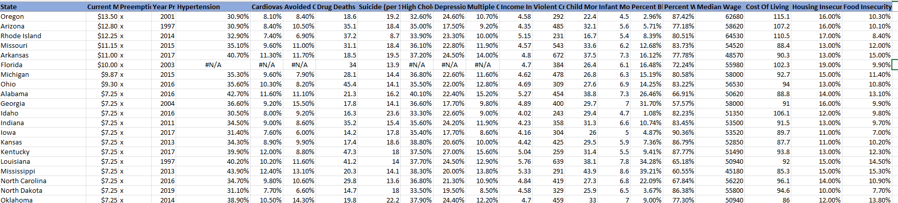
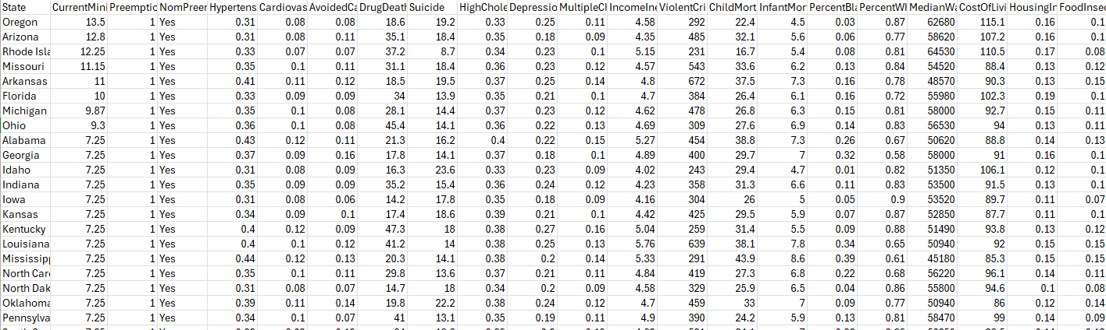
cleaned/wrangled dataset

Slide 17
data wrangling
CDS DATAset
Removed all Universities without available 2022-2023 CDS (9)
Applied Imputations for Missing Values
Categorical - Mode
Numerical – Median
Adjusted Column Names
Removed spaces
Clarified Names
Data format was mostly clean
Combined with original dataset on State variable
Added additional columns for analyses (e.g., percent women/Asian)
Applied Z-Score normalization for visualization

Slide 18
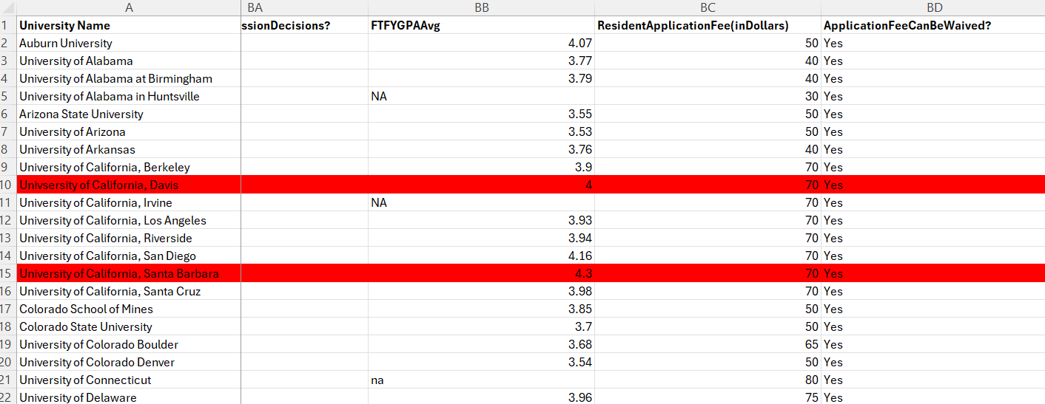
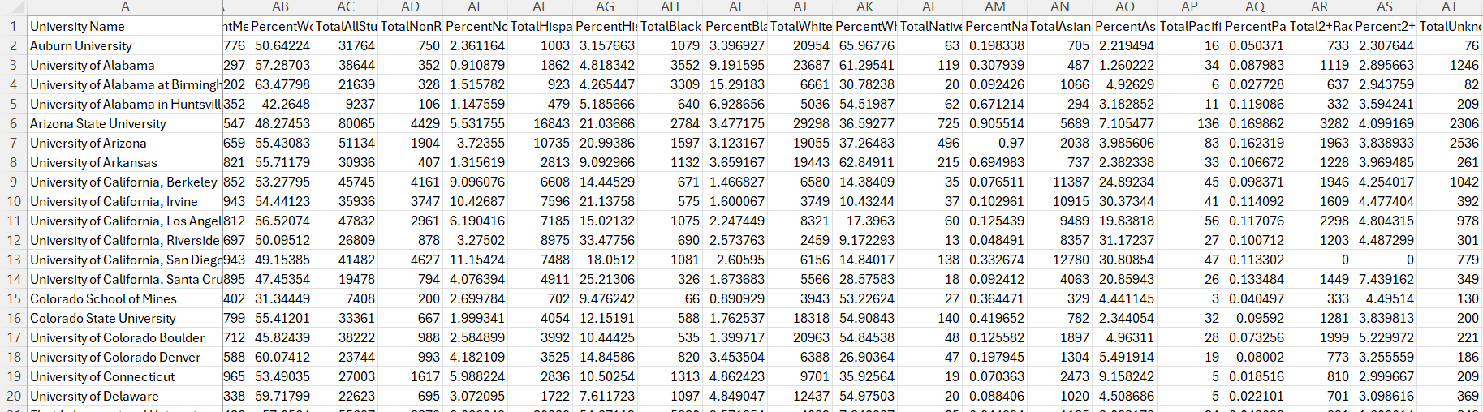
cleaned/wrangled dataset

Slide 19
project Experimental design
Variable Distribution/Data Anomalies
Supervised Machine Learning
Unsupervised Machine Learning
Feature Selection
Pearson Correlation with P-Value
Notes:
This project is done concurrently with another class, adding requirements and features for capstone, working with research mentors.
**who is the audience, where is the data from, what are we trying to find
Project is a part of the **spell out arise acronym**(ARISE) and KDSC
**information about project serving a community partner – the Wyandotte county people ☺
Investigating effects of minimum wage and minimum wage preemption on negative health effects and educational outcomes
Original project goals:
Investigating effects of minimum wage preemption on health outcomes
Additional project goals:
Investigating effects of minimum wage and minimum wage preemption on health and educational outcomes

Slide 20
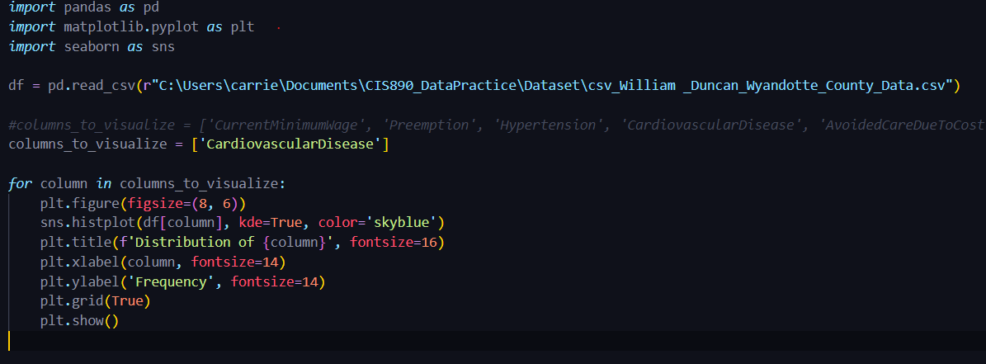
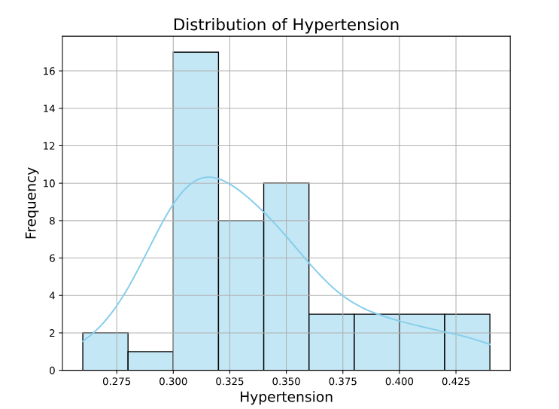
Graph Distributions script
Example Output

Slide 21
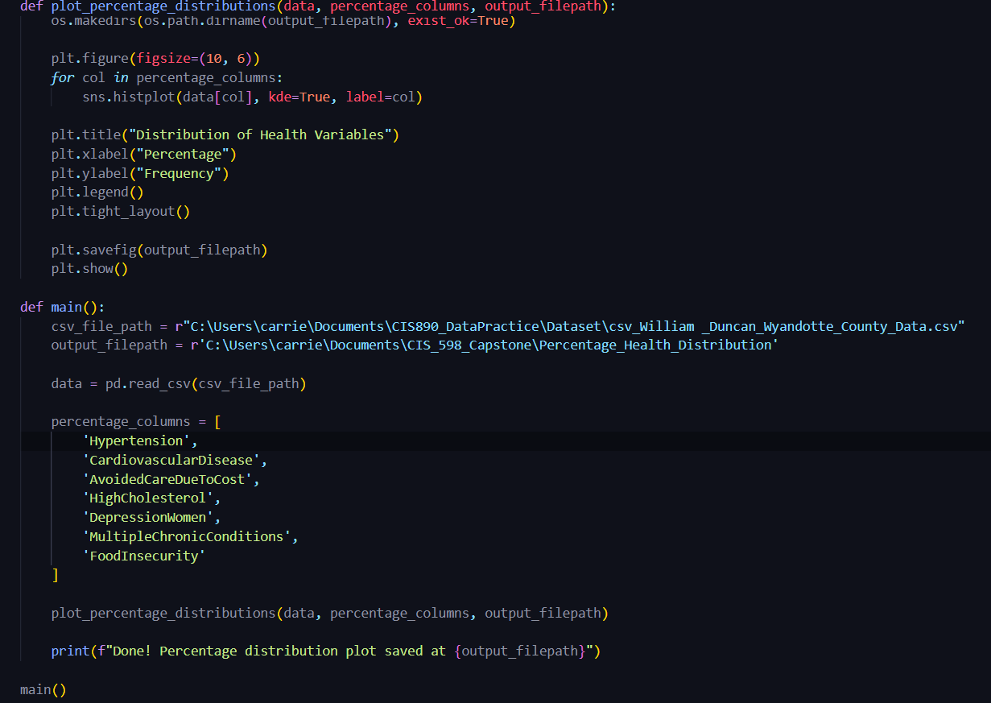
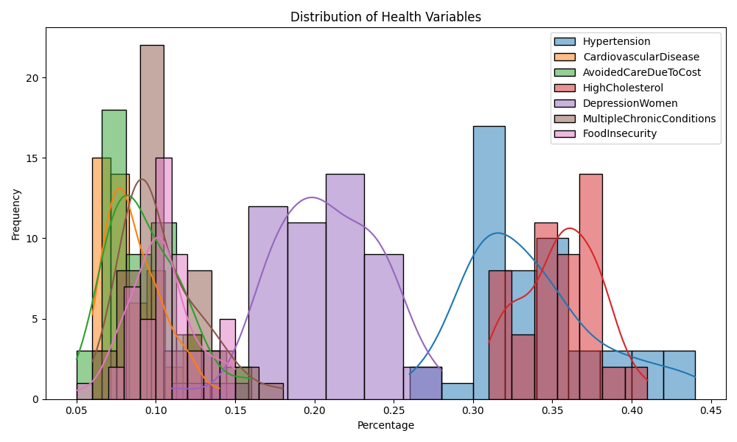
graphing health distributions

Slide 22
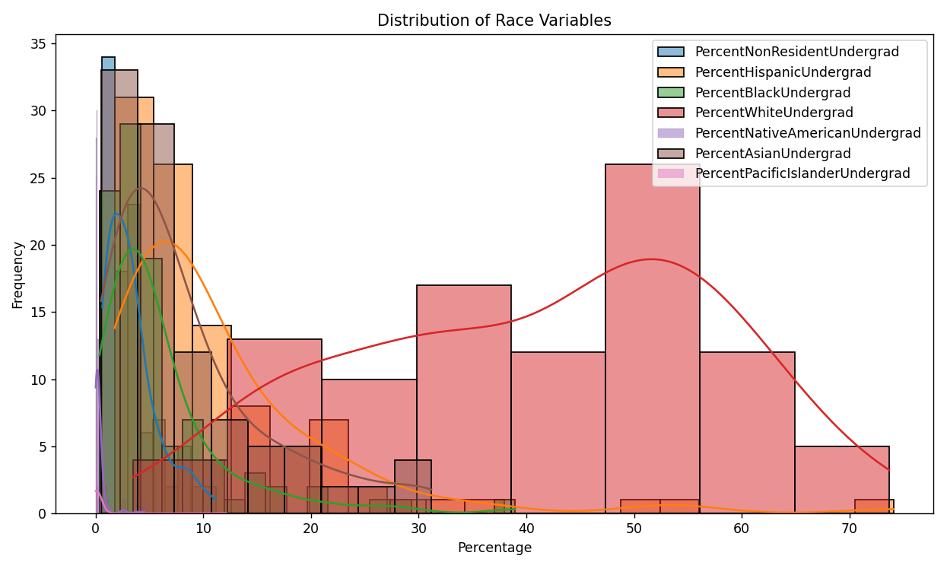
graphing race distributions

Slide 23
Data Science life cycle
Domain Knowledge and Research Design
Data Planning and Data Collection
Data Cleaning - Data wrangling
Data Exploration - Feature Engineering
Data Exploration - Feature Selection
Model - Model Design
Model - Model Evaluation
Communication and Propose Action

Slide 24
feature selection
Algorithms Applied:
CfsSubsetEval with Best First
CorrelationAttributeEval with Ranker
Python Scripts - Top 5,10 features
SelectKBest with F Regression
SelectKBest with Mutual Info Regression
Recursive Feature Elimination (RFE) with Linear Regression Estimator
Tools Used: Weka, Scikit Learn

Slide 25
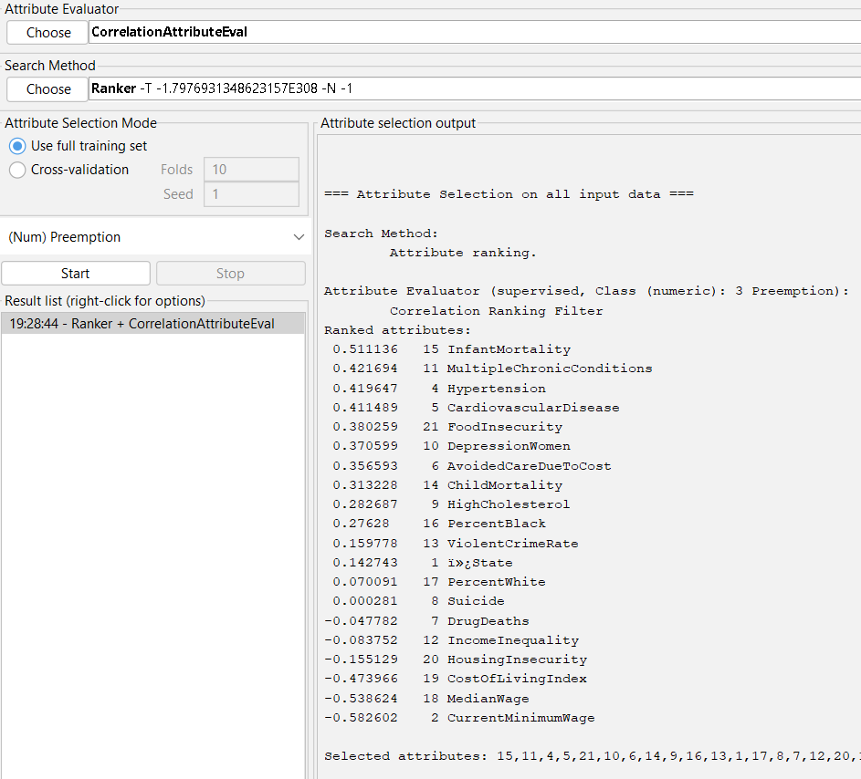
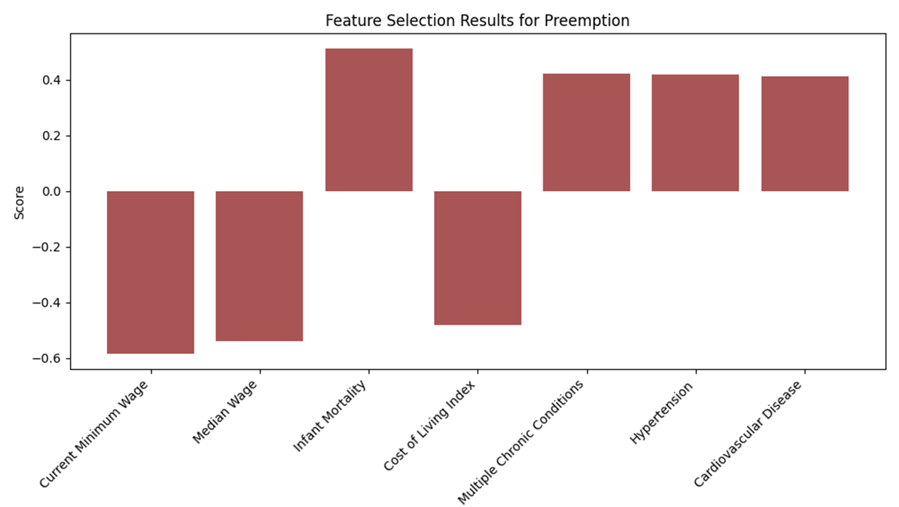
weka feature selection

Slide 26
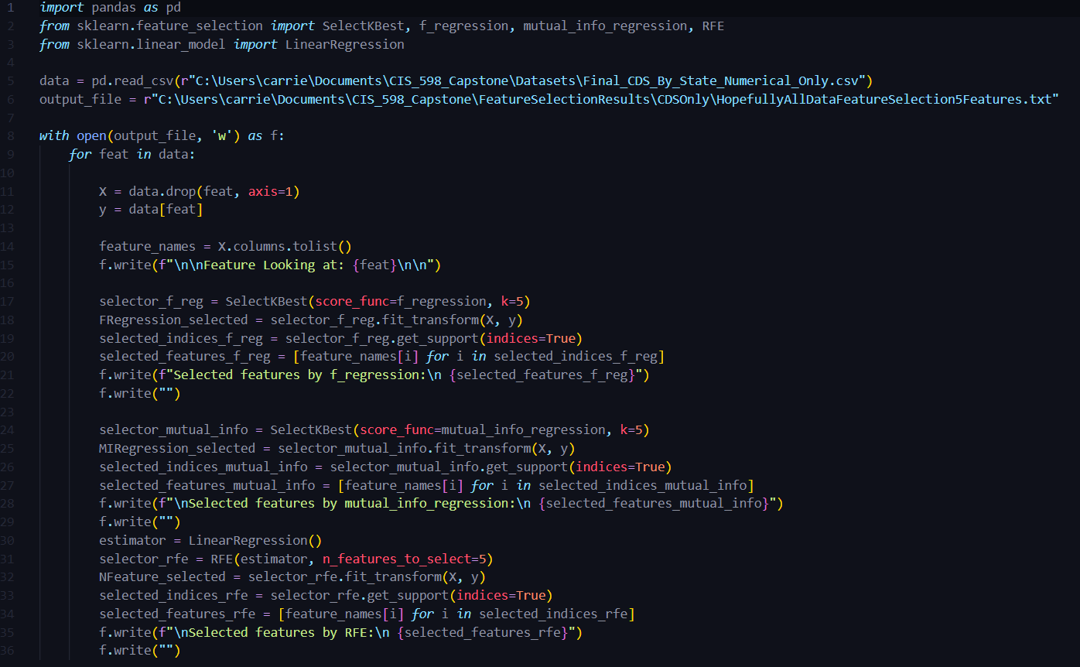
feature selection scikit learn, python

Slide 27
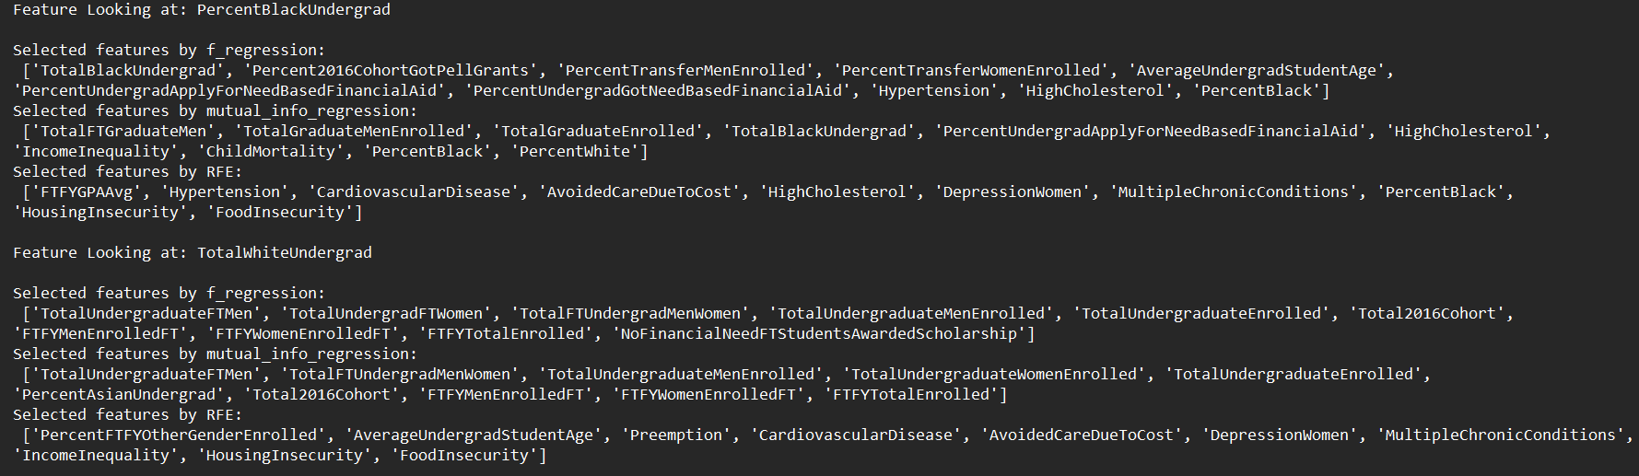
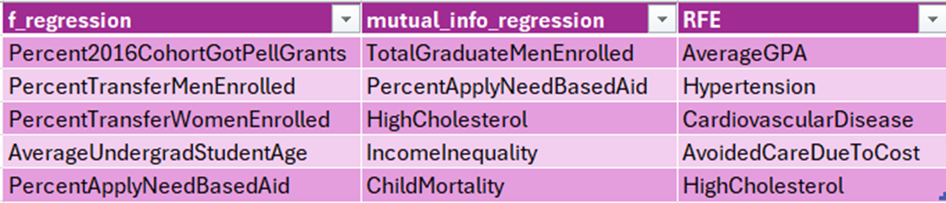
sample output

Slide 28
Data Science life cycle
Domain Knowledge and Research Design
Data Planning and Data Collection
Data Cleaning - Data wrangling
Data Exploration - Feature Engineering
Data Exploration - Feature Selection
Model - Model Design
Model - Model Evaluation
Communication and Propose Action
Notes:
Not doing this one yet – it’s understanding the strength of each column over the data

Slide 29
supervised machine learning
Algorithms Applied:
ZeroR
RandomForest
K-Nearest Neighbor (7)
Linear Regression
Tools Used: Weka, Scikit Learn
Notes:
Because of time limit, focusing more on motivation and results, less on specific algorithms.

Slide 30
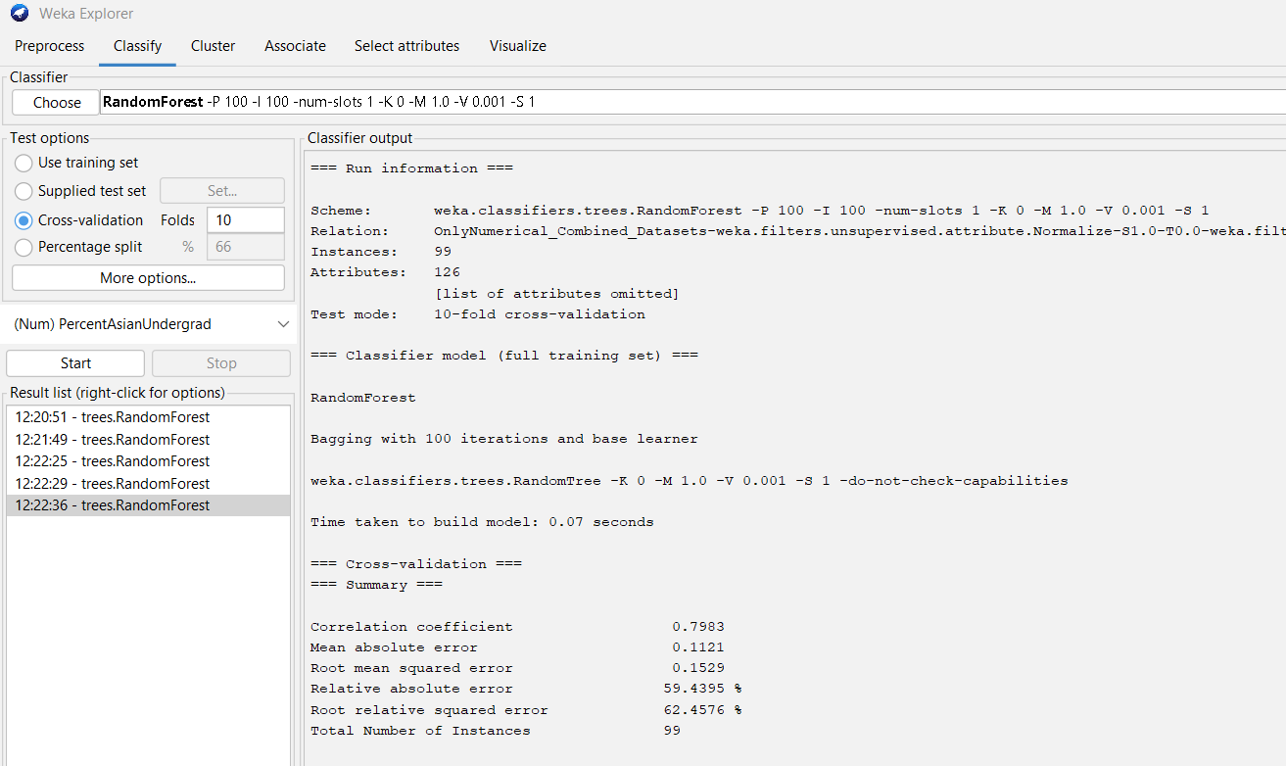
weka machine learning

Slide 31
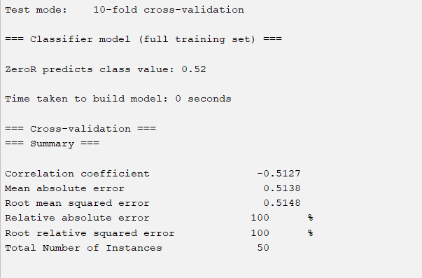
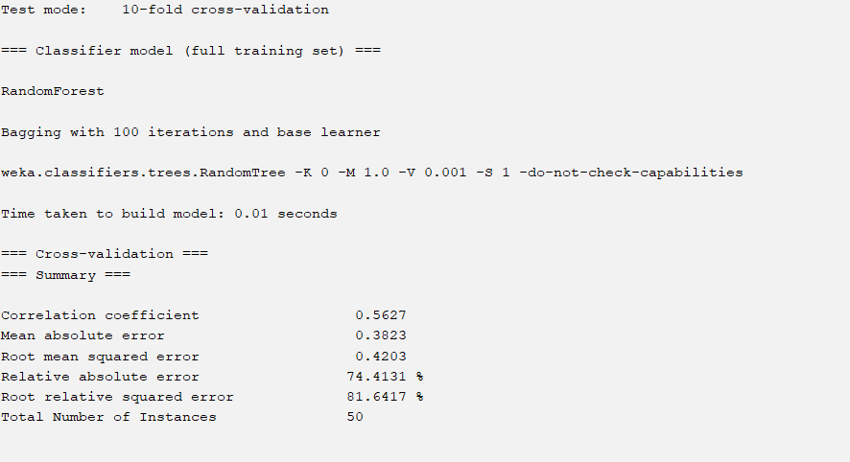
outcome example: preemption

Slide 32
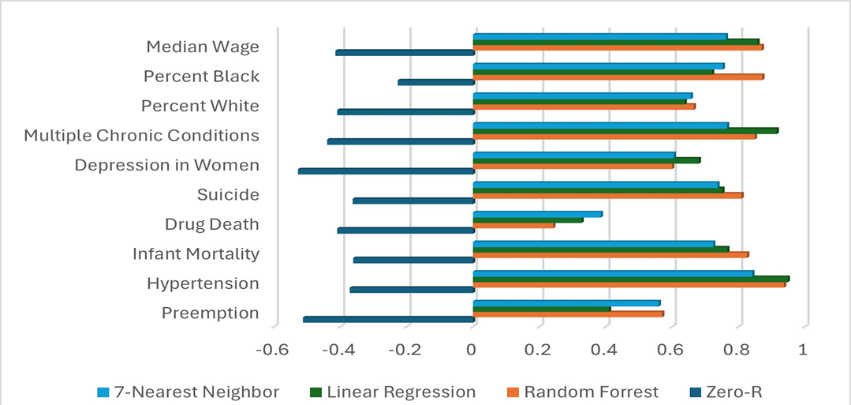
visualized health dataset outcomes

Slide 33
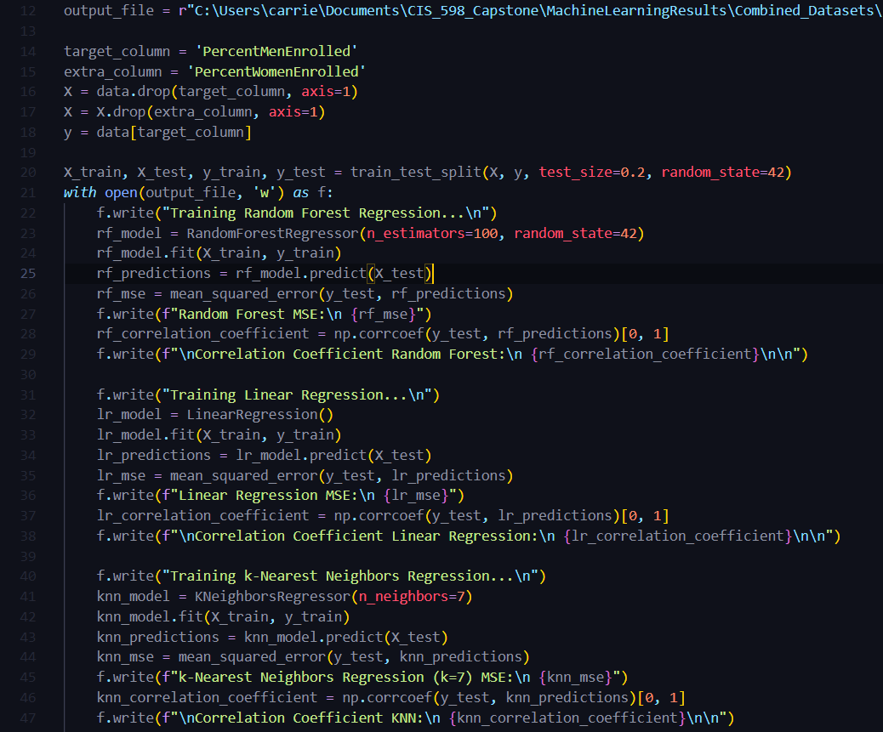
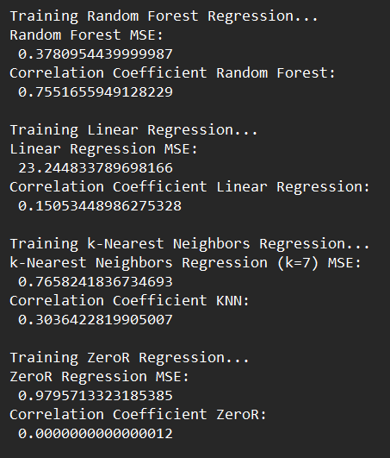
machine learning scikit learn, python
Sample Output

Slide 34
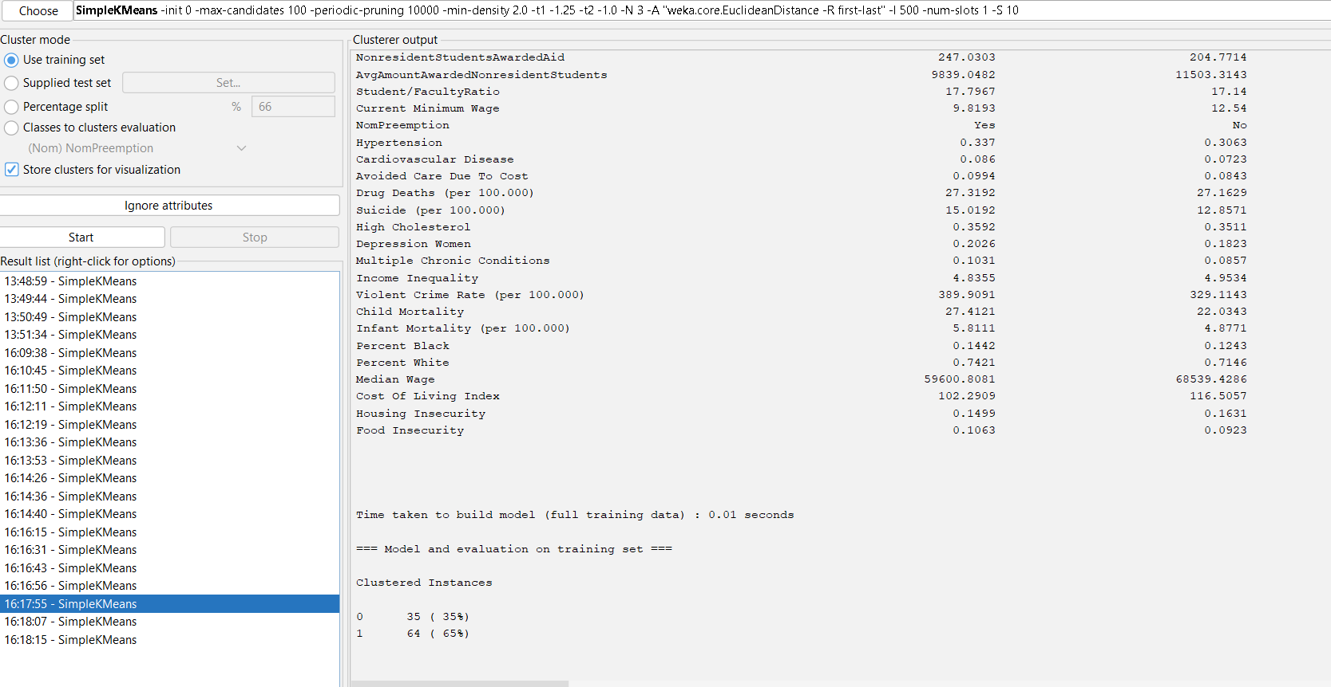
unsupervised machine learning
Notes:
kmeans, 2 clusters

Slide 35
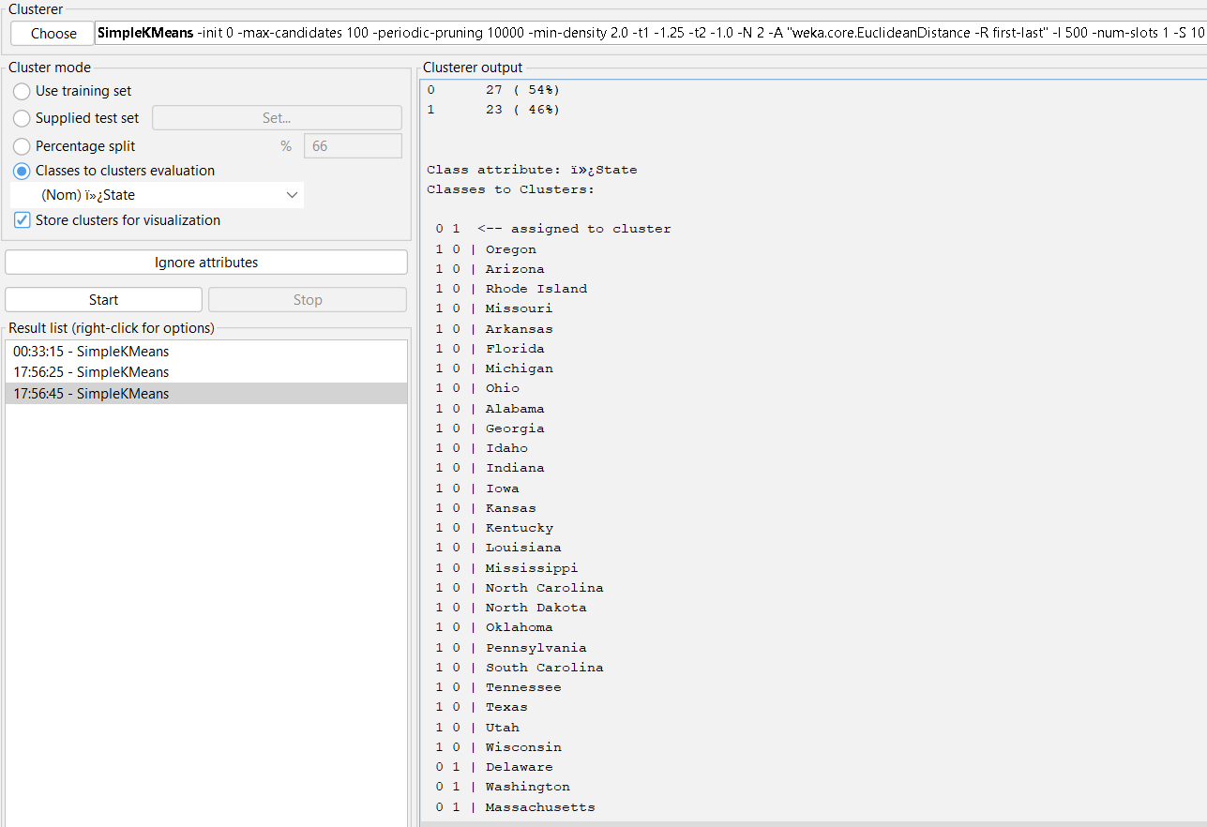

Slide 36
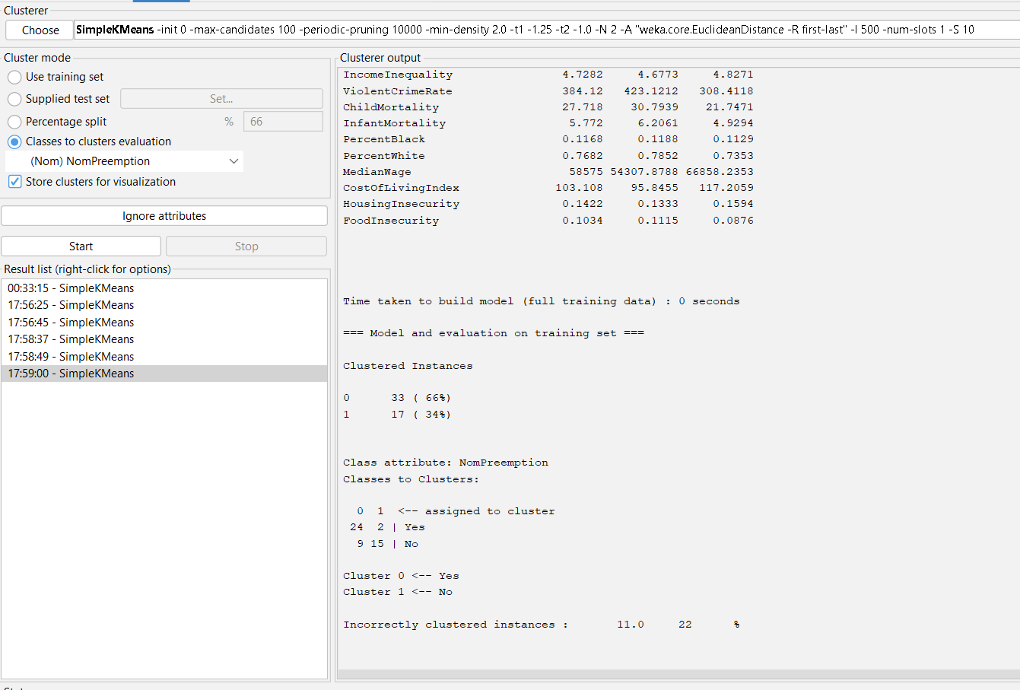

Slide 37
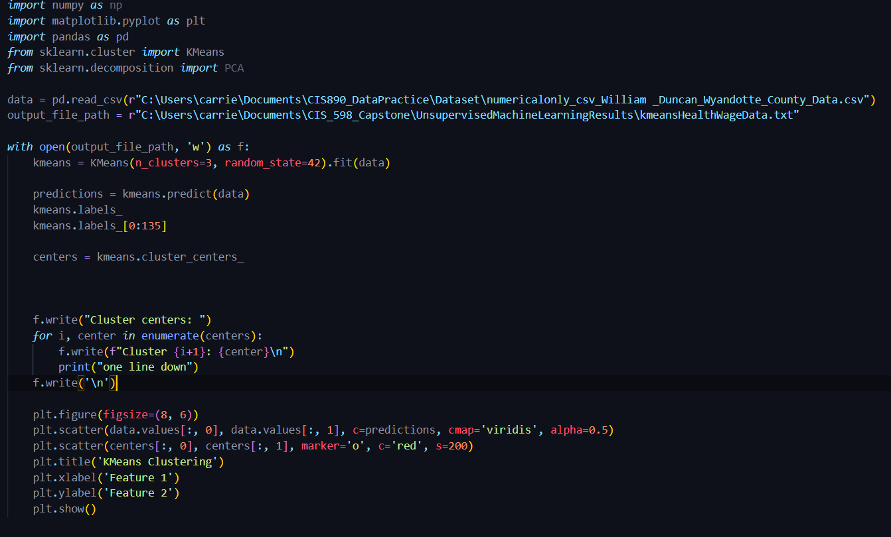
unsupervised machine learning

Slide 38
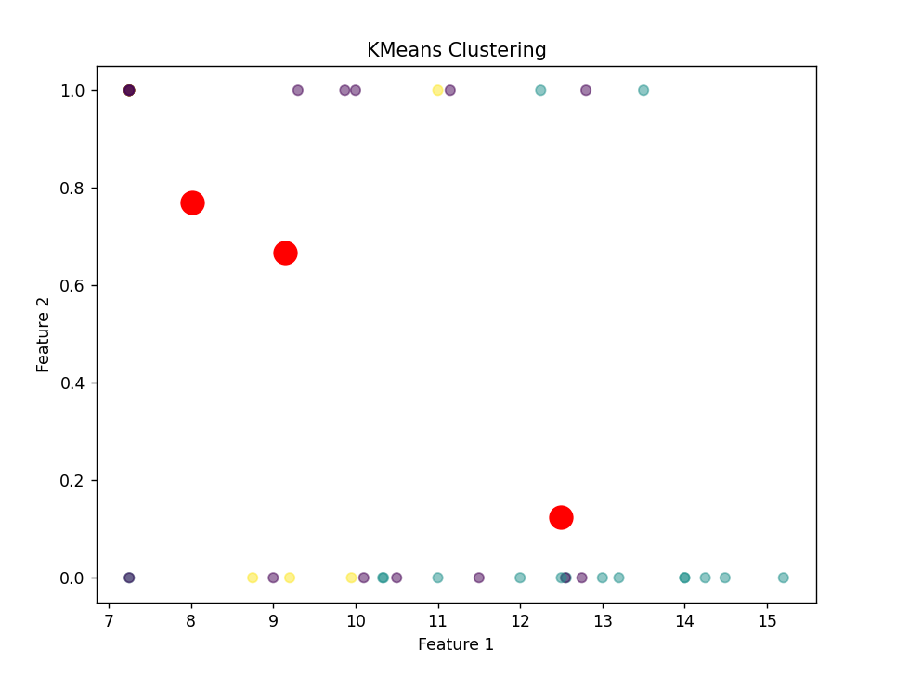
kmeans results - no pca
Notes:
principal component analysis

Slide 39
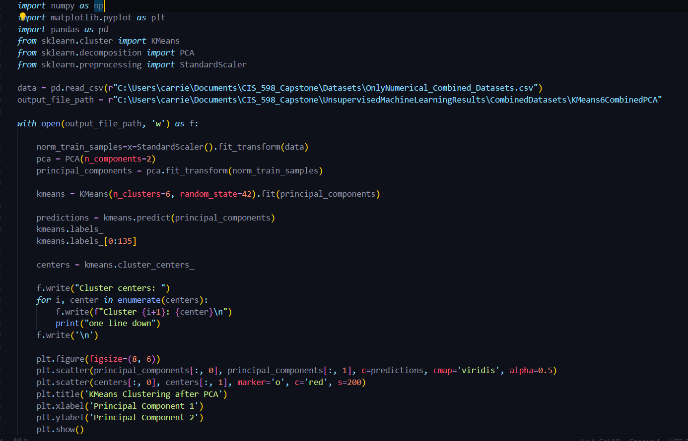
first attempt - pca before kmeans
Notes:
*** PCA should come after clustering

Slide 40
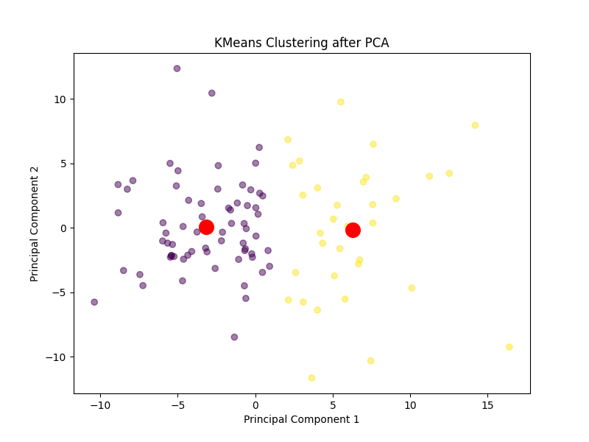
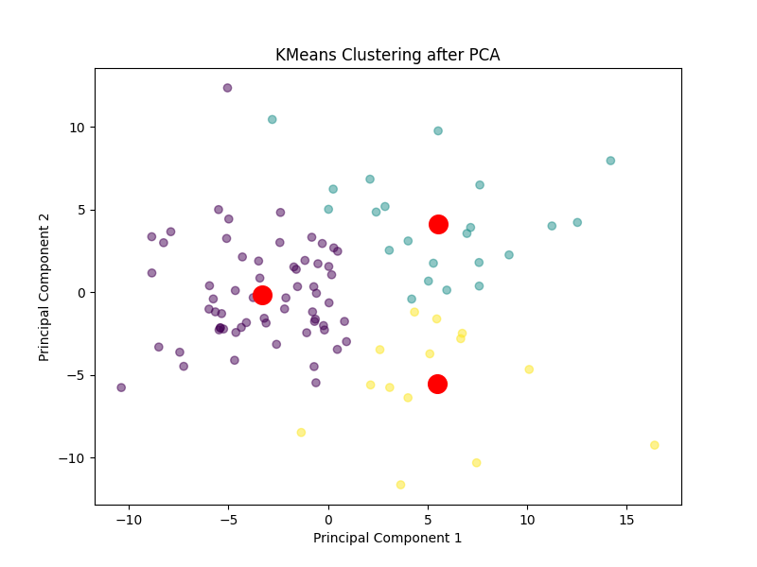
first attempt pca results

Slide 41
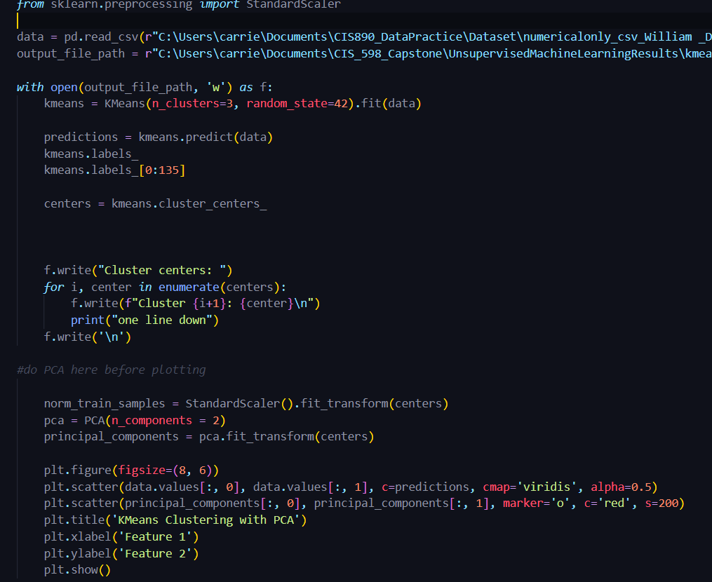
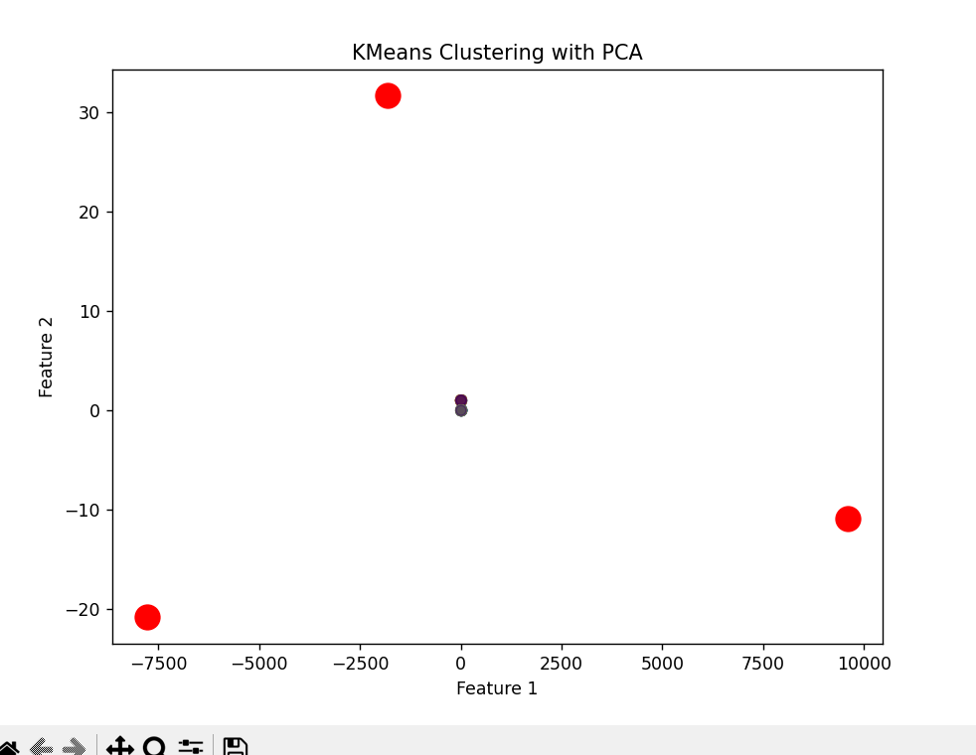
pca after kmeans attempt/results

Slide 42
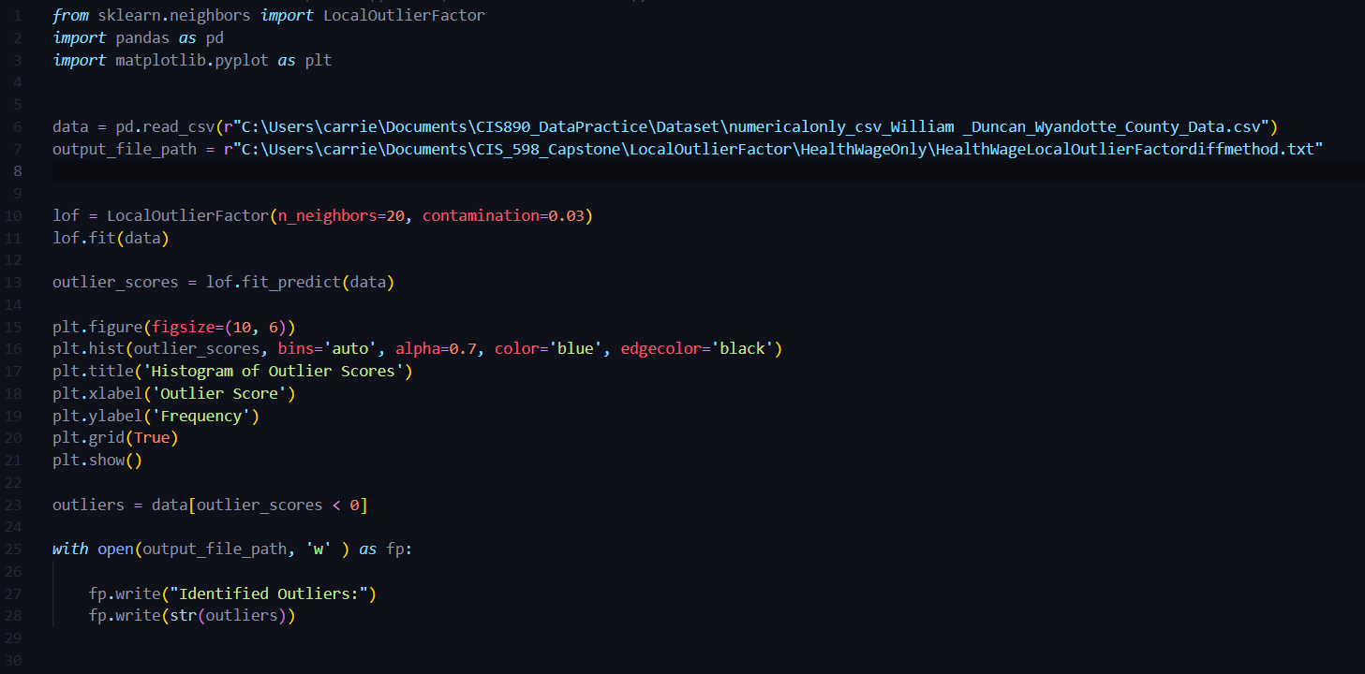
local outlier factor, 20n

Slide 43
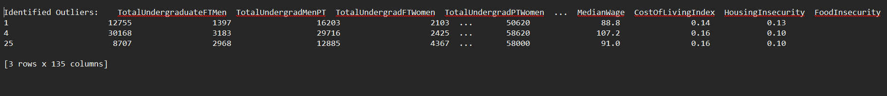
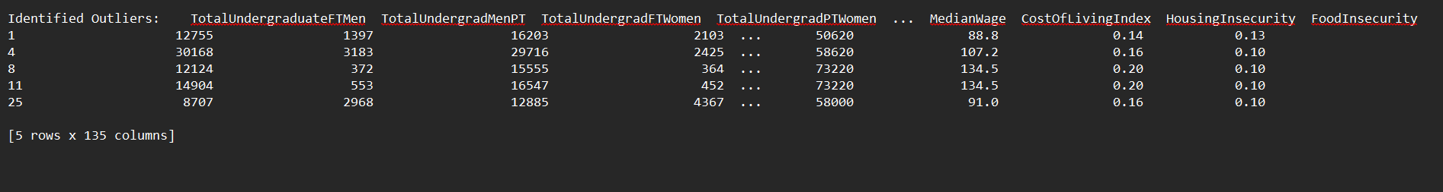
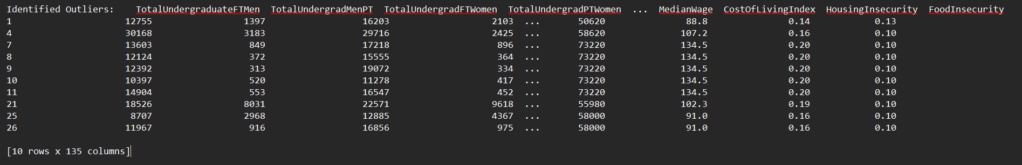
lof results

Slide 44
Data Science life cycle
Domain Knowledge and Research Design
Data Planning and Data Collection
Data Cleaning - Data wrangling
Data Exploration - Feature Engineering
Data Exploration - Feature Selection
Model - Model Design
Model - Model Evaluation
Communication and Propose Action
Notes:
Not doing this one yet – it’s understanding the strength of each column over the data

Slide 45
result validation
Dividing dataset into training/testing
Testing results against ZeroR (machine learning)
Running analyses with and without outliers (feature selection)
Checking the predictions
Pearson Correlation for P-value and significance

Slide 46
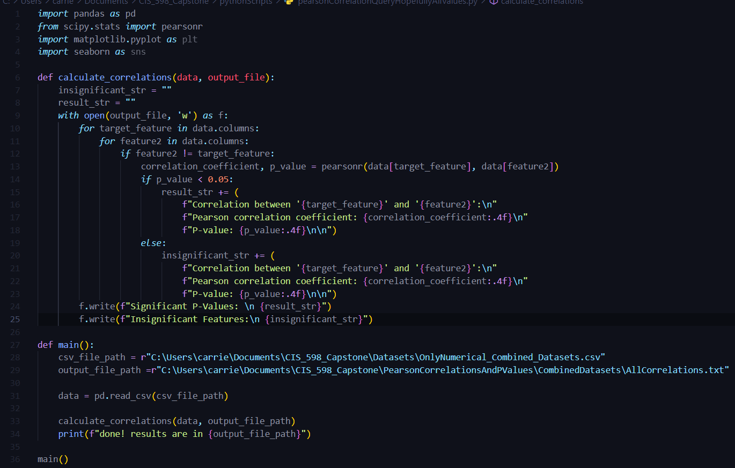
pearson correlation script

Slide 47
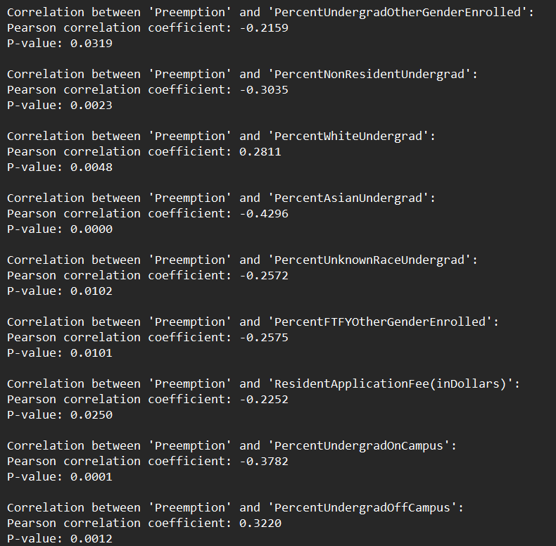
Sample output

Slide 48
Data Science life cycle
Domain Knowledge and Research Design
Data Planning and Data Collection
Data Cleaning - Data wrangling
Data Exploration - Feature Engineering
Data Exploration - Feature Selection
Model - Model Design
Model - Model Evaluation
Communication and Propose Action

Slide 49
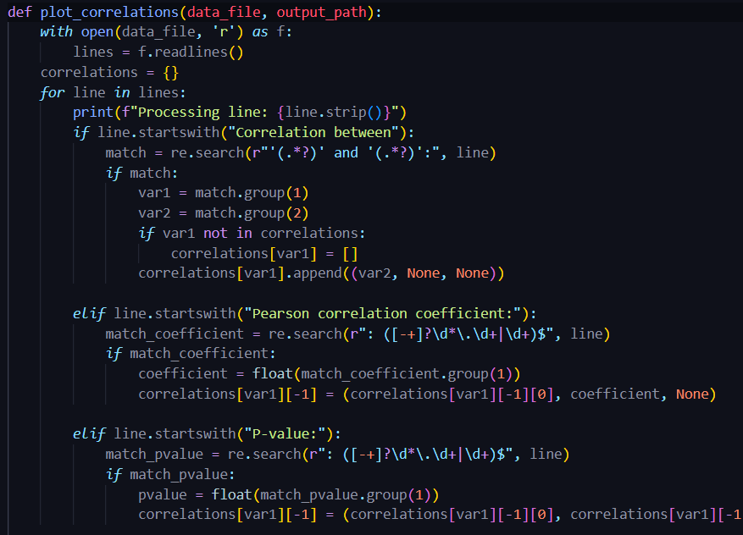
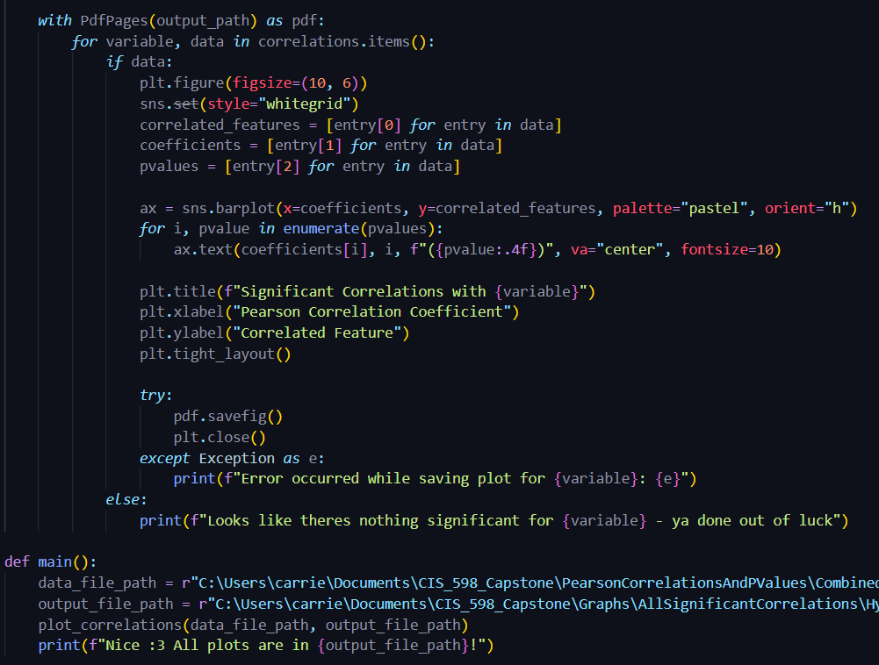
graph correlations script

Slide 50
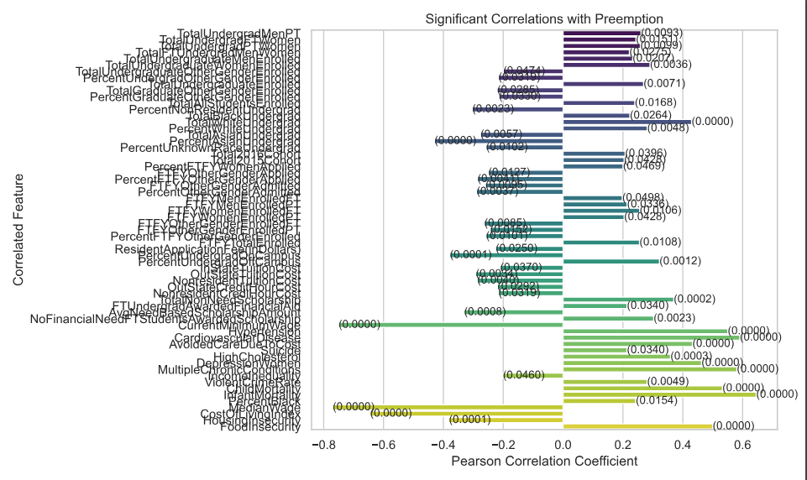
original result

Slide 51
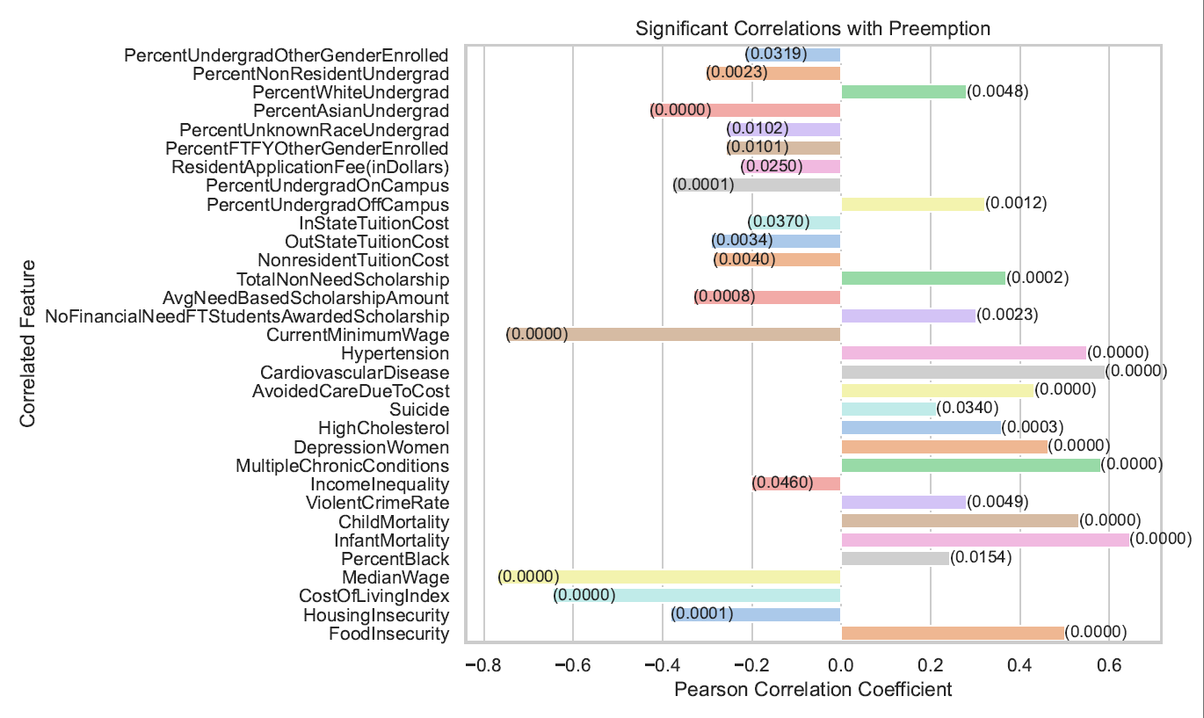
modified/non-trivial results
Notes:
removed trivial results, made colors more readable.

Slide 52
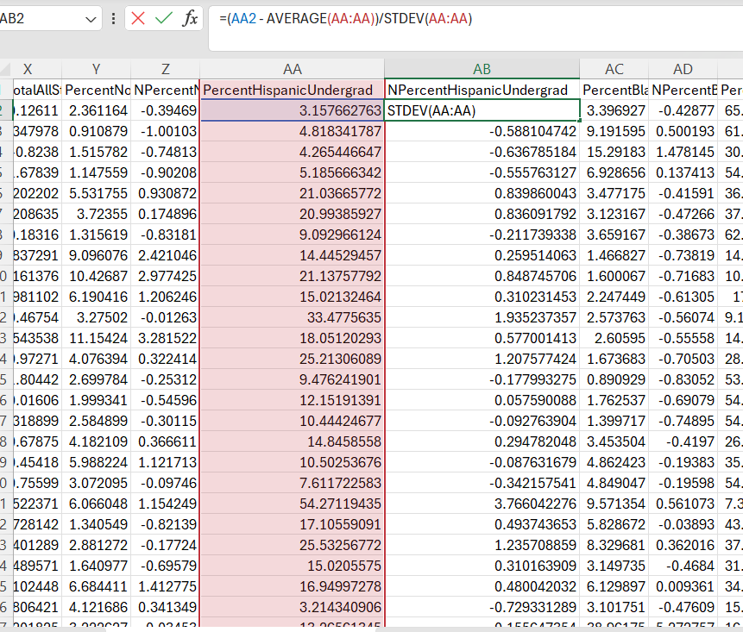
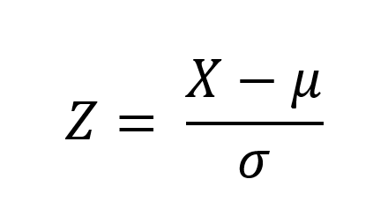
z-score normalization for visualization
Z-Score Normalization
Calculated in Excel
Created normalized dataset for visualization

Slide 53
results & interpretation

Slide 54
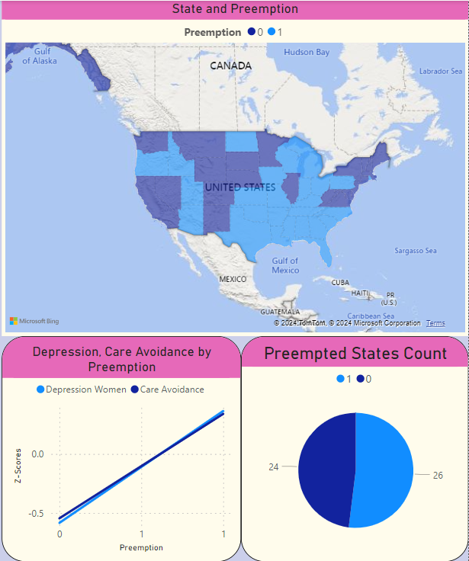
Power bi dashboard

Slide 55
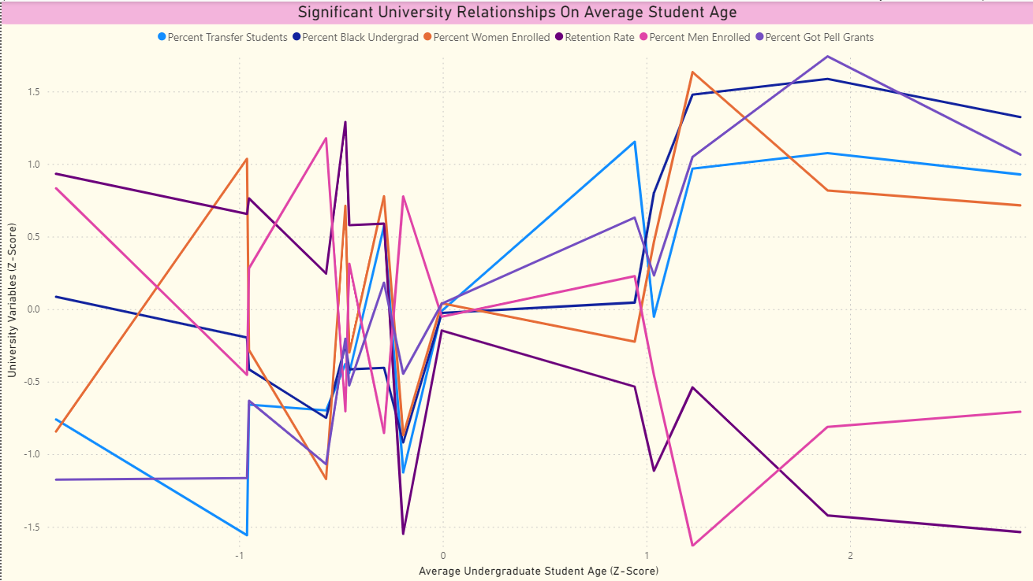

Slide 56
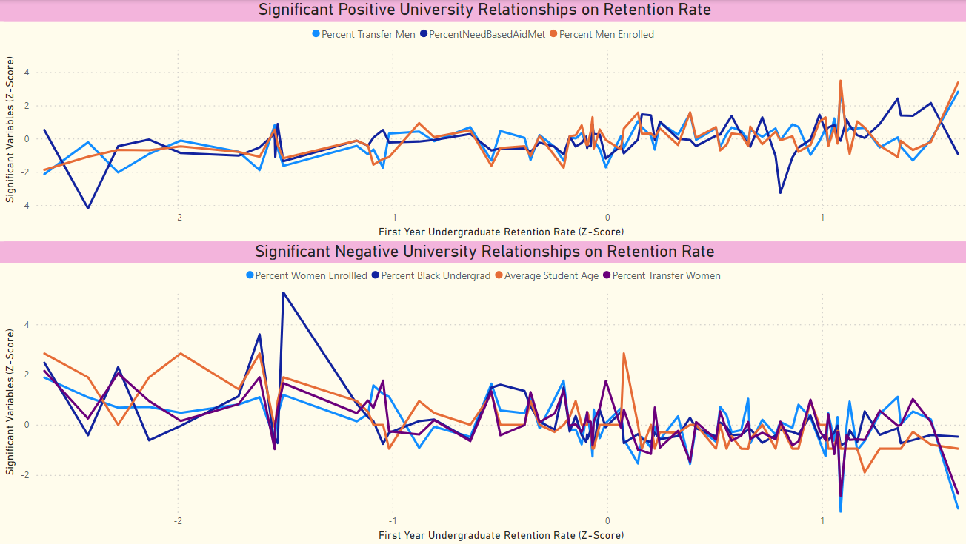

Slide 57
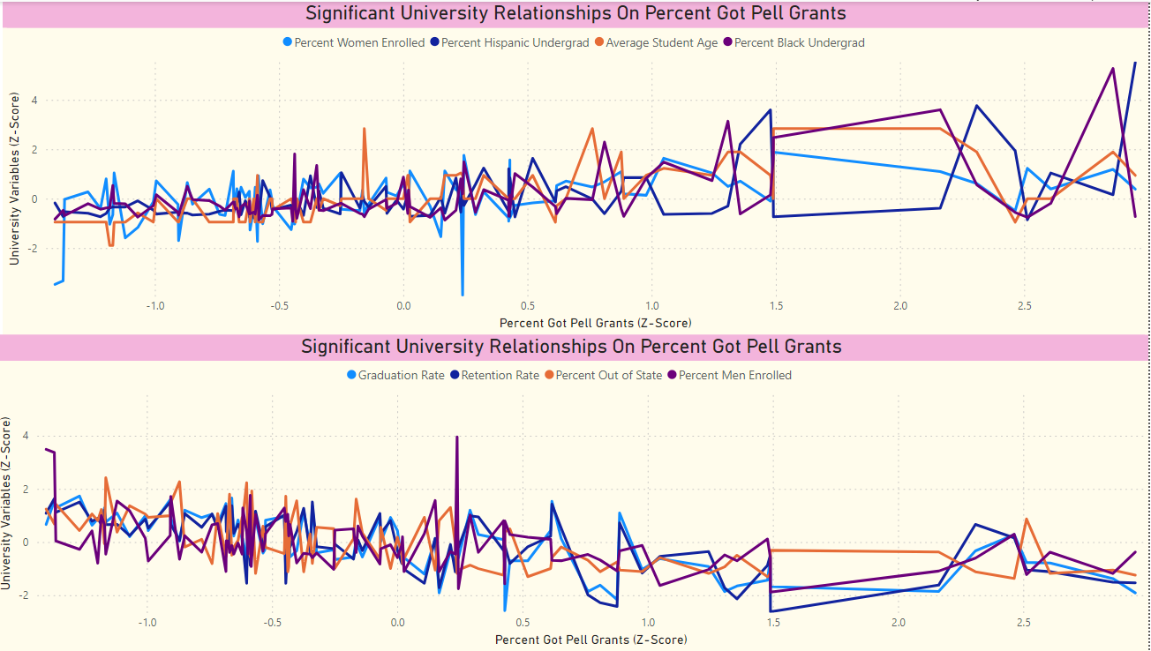

Slide 58

Notes:
Attended PowerBI workshop at KDSC conference where improved visualization skills

Slide 59


Slide 60


Slide 61


Slide 62


Slide 63
publication Pathway
Poster presentations
KDSC – Friday, April 26th
COE Design Showcase – Friday, May 3rd
Grace Hopper (?)
Potential paper publication
Not clear where will submit
Manuscript in Progress

Slide 64

kdsc!

Slide 65


Slide 66


Slide 67
project insights/obstacles
Work more with PowerBI
Get more comfortable with features/capabilities
Continuously discovered new features
Organize results/work better (and save more often)
Had to re-run analyses due to not saving them in an organized way initially
Lost work on PowerBI when program crashed
Determining sampling method for CDS data
Flexible Python script for data scraping
Save time on data collection
Unsupervised Machine Learning in Python with Scikit
Visualization of results with PCA after KMeans to reduce dimensionality
Haven’t gotten scripts to work correctly

Slide 68
future work
Further Collaboration with KDSC Partners
Add gender/racial data by state
Compare college population against general population
Add K-12 Educational Data (access via National Education Statistics)
Will be more representative of the population

Slide 69
THANK YOU! Questions?

Slide 70


Slide 71


Slide 72


Slide 73


Slide 74


Slide 75


Slide 76



